Slide 1
Unit-V
INTELLECTUAL PROPERTY

Slide 2
Economics behind development of IPR
Intellectual Property Rights (IPR) are critical to the development and innovation in an economy. The economics behind the development of IPR revolves around several key principles and impacts:
1. Incentivizing Innovation and Creativity
2. Promoting Economic Growth
3. Market Expansion
4. Balancing Interests
5. Legal and Economic Institutions
6. Economic Costs and Benefits
7. IPR and Knowledge Spillovers

Slide 3
Economics behind development of IPR
1. Incentivizing Innovation and Creativity:
- Monopoly Power: IPR grants temporary monopoly power to creators and innovators by protecting their inventions, designs, brands, and creative works from unauthorized use. This exclusivity allows them to recoup the investments made in research and development (R&D).
- R&D Investments: The protection provided by IPR encourages firms and individuals to invest in R&D, knowing they can potentially reap financial rewards without immediate competition copying their innovations.
2. Promoting Economic Growth:
- Productivity Gains: Innovations protected by IPR can lead to significant productivity gains. New technologies, processes, and products improve efficiency and effectiveness across various sectors of the economy.
- Industry Growth: Sectors with strong IPR protection, such as pharmaceuticals, technology, and entertainment, tend to experience rapid growth. These industries often rely heavily on IPR to protect their investments and stimulate further development.

Slide 4
Economics behind development of IPR
3. Market Expansion:
Global Trade: Strong IPR protection can facilitate international trade by providing confidence to foreign investors and companies that their IP will be protected. This can lead to increased exports and imports of high-tech goods and services.
Foreign Direct Investment (FDI): Countries with robust IPR regimes often attract more FDI. Multinational companies prefer investing in markets where their innovations and brands are protected.
4. Balancing Interests:
Access vs. Incentives: There is a delicate balance between providing incentives for innovation and ensuring access to new technologies and medicines. For instance, while patent protection encourages pharmaceutical companies to develop new drugs, it can also lead to high prices, restricting access for some populations.
Duration of Protection: The duration of IPR protection (e.g., patents typically last 20 years) is designed to balance the need to reward innovators and eventually allow public access to the innovations.

Slide 5
Economics behind development of IPR
5. Legal and Economic Institutions:
Legal Framework: A well-functioning legal system is crucial for the enforcement of IPR. Clear laws, effective judicial processes, and enforcement mechanisms ensure that rights holders can protect their IP.
- Economic Institutions: Institutions like patent offices, regulatory bodies, and international organizations (e.g., WTO, WIPO) play key roles in the administration and harmonization of IPR globally.
6. Economic Costs and Benefits:
- Costs: Implementing and enforcing IPR can be costly for governments and businesses. There are administrative costs, legal fees, and the potential for anti-competitive practices that can arise from excessive IP protection.
- Benefits: The benefits include enhanced innovation, economic growth, job creation, and improvements in standards of living. IPR also fosters a competitive market environment, leading to a diverse range of products and services.

Slide 6
Economics behind development of IPR
7. IPR and Knowledge Spillovers:
Knowledge Diffusion: While IPR protects individual innovations, it also encourages the diffusion of knowledge. Published patents, for example, disclose technical details that others can learn from and build upon once the protection expires.
Collaborations: IPR can facilitate collaborations and partnerships, as clear ownership of IP encourages companies to share knowledge and work together without fear of losing their competitive edge.
The development of IPR is a complex interplay of encouraging innovation, promoting economic growth, balancing interests, and ensuring effective legal and economic frameworks. By understanding and strategically managing these aspects, economies can harness the full potential of IPR to drive development and prosperity.

Slide 7
Intellectual Property Rights

Slide 8
A Fundamental Principle of
Intellectual Property Rights Is
To Protect The Creator From Infringement

Slide 9
Intellectual Property Rights (IPR)
Intellectual Property means the legal rights which results from intellectual activity in industrial, scientific, literary and artistic fields.
Intellectual Property Rights are the exclusive rights granted to the owner of the said property for a certain time period for its commercial exploitation subject to the provisions of national laws and international agreements, with a view to reward the intellectual creativity.

Slide 10
Intellectual Property Rights (IPR)
IP owner can sell or license or mortgage their IP
These rights safeguards the creators from unauthorized access of their IP.
These rights promote creativity, encourages fair-trading, and in turn contributes to economic, scientific and social development.
These rights increase market value of a business.
IP protection is not a choice but a necessity for a business to gain and maintain a competitive edge in the global market.

Slide 11
Types of Intellectual Property Rights
Patents
Trademarks
Copyrights
Industrial Designs

Slide 12
PATENT
PROTECT YOUR IDEA

Slide 13
What is a Patent?
Patent is an exclusive ownership right granted by the government to the owner of an invention, in exchange for the public disclosure of the invention.

Slide 14
Rights of a Patentee
Exclusive right to prevent third parties from:
Making
Using
Offering for sale
Selling
Importing product or the product obtained directly by the patented processc

Slide 15
What is an Invention?
Invention means
a product or process or both
be novel
involves an inventive step
be capable of industrial application
not fall under Sections 3 and 4 of the Patents Act, 1970

Slide 16
Novelty
An invention is considered to be novel, if it is not known to the public through publication or prior use anywhere in the world before filing a patent application.
Prior art
Patents
Scientific Papers
Journals , Magazines & Report Articles
Books, Manual, Catalogues & Brochures
Public discussions (conference and seminar)
Newspapers
Products, etc

Slide 17
INVENTIVE STEP
“Inventive step" means a feature of an invention that involves technical advance as compared to the existing knowledge or having economic significance or both and that makes the invention not obvious to a person skilled in the art.

Slide 18
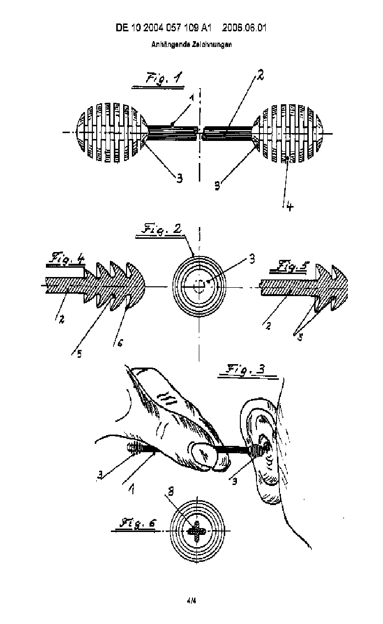
INVENTIVE STEP
Example:
Ear cleaning bud with a ball-like elastic body made of flexible plastic, instead of cotton swab

Slide 19
INDUSTRIAL APPLICABILITY
Invention is capable of being made or used in an industry

Slide 20
Provisional Specification
If the invention is still under research or development or experimentation stage and a delay is expected in attaining the final stage
Secures priority date
Complete specification should be filed within 12 months from the date of filing of provisional specification
Filing of Drawings & Claims are optional in Provisional Specification
If two or more provisional specifications filed by an applicant are cognate or if one is a modification of the other, the applicant may file one complete specification covering all the provisional applications.

Slide 21
Complete Specification
Submission of complete specification is necessary to obtain a patent :
Title
Abstract
Field of Invention
Background
Description of the Invention
Drawings
Claims

Slide 22
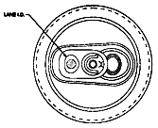

Example
Ring-pull Cans
The inventor licensed the system for opening Coca-Cola cans at 1/10 of a penny per can. During the period of validity of the patent the inventor obtained 1,48,000 UK pounds a day on royalties.

Slide 23

Example
Post-it Notes
The glue used for Post-its was invented by chance by 3M.
Initially ignored by the inventor but valued by the manager, it was then patented. It subsequently brought huge profits to the company through licensing agreements.

Slide 24
Why Patent Search
Avoid wastage of time, money and resources on an invention that would not be patentable
Competitor tracking
Avoid patent infringement
Technology tracking
Licensing opportunities

Slide 25
Who can apply for a patent?
An application for a Patent for an invention may be
made by any of the following persons either alone or
jointly with any other person:
True and first inventor
True and first inventor‘s assignee
Legal representative of deceased true and first inventor or his/her assignee

Slide 26
Unity of Invention
Claims of a Complete Specification shall relate to a single invention, or to a group of inventions linked so as to form a single inventive concept

Slide 27
Type of Patent Applications
1. Ordinary Application
2. Convention Application
3. PCT Application
4. Divisional Application
5. Patent of Addition

Slide 28
Convention Application
An application filed in India claiming a priority date based on the same or substantially similar application filed in one or more of the convention countries.

Slide 29
PCT Application
An international application filed under the Patent Cooperation Treaty, designating India as one of the countries where the applicant seeks protection.

Slide 30
Divisional Application
If the parent application describes more than one invention then applicant is required to split the parent application into one or more divisional applications each claiming only a single invention.

Slide 31
Patent of Addition
Patent application - for an improvement or modification of the invention described or disclosed in main application for which a patent already granted or applied for
No Renewal Fees
Term of Patent expires along with the main Patent

Slide 32
Residents Not To Apply For Patents Outside India Without Prior Permission
Residents of India require prior permission to apply for patents outside India under following circumstances:
The applicant or inventor is Indian resident
Applicant does not wish to file patent application in India prior to filing outside India
If the applicant is Indian resident, a patent application has been filed in India and six weeks period is not yet over from that date
The invention relates to atomic energy or defence purpose. However if the invention is relevant for Defence or Atomic Energy purpose, no permission shall be granted without the consent of Central Government.

Slide 33
Residents Not To Apply For Patents Outside India Without Prior Permission
Penalties for Non-Compliance :
Imprisonment for a term up to Two Years
Fine
Both Imprisonment and Fine
Abandonment of Indian Patent Application
Revocation of Indian Patent Grant

Slide 34
In which language can an application for patent be filed with the Indian Patent Office?
An application for patent can be filed either in Hindi or English

Slide 35
Foreign Patent Filing
Patent protection is Territorial Right
Obtain patent in each country where you want to protect your invention.
There is no Patent Valid Worldwide
Paris Convention ~177 Countries
Patent Cooperation Treaty (PCT) ~ International Patent System - 152 Countries

Slide 36
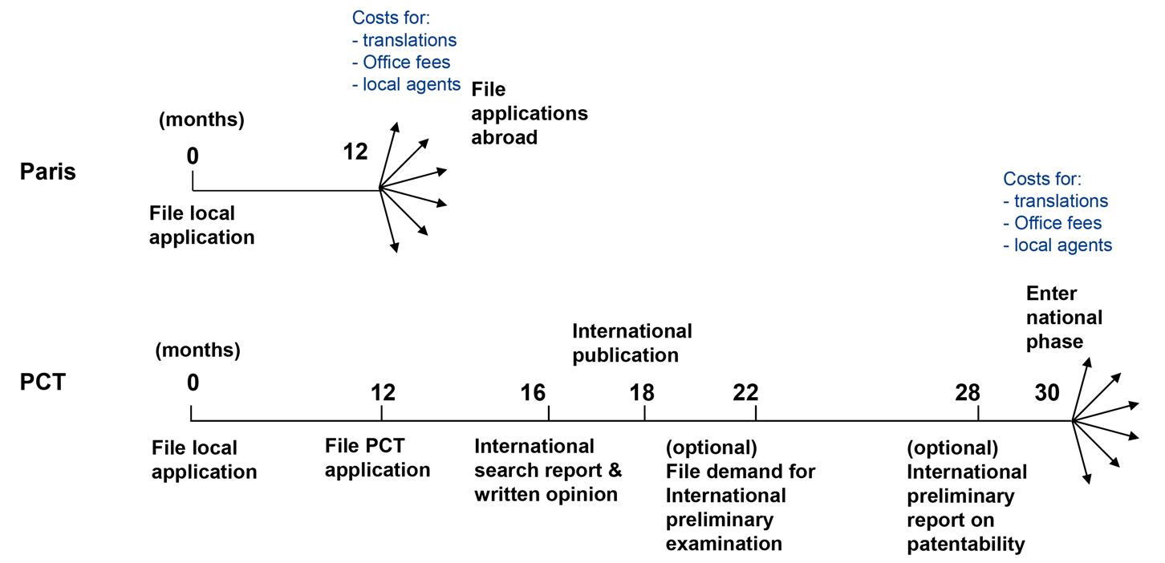
Foreign Patent Filing

Slide 37
Term of Patent
The term of Patent is 20 years from the date of filing of application
For application filed under national phase under Patent Cooperation Treaty(PCT), the term of patent will be 20 years from the International filing date.

Slide 38
Trademarks

Slide 39
Trade Marks
A Trademark (popularly known as brand name) is a visual symbol
- which may be a name, device, word, signature, label, numeral, shape of goods, packaging or combination of colours or any combination
- used by one undertaking on goods or services or other articles of commerce to distinguish it from other similar goods or services originating from a different undertaking.

Slide 40



Examples
WORD - JAVA / MICROSOFT
LOGO -
NBC's peacock style design

Slide 41

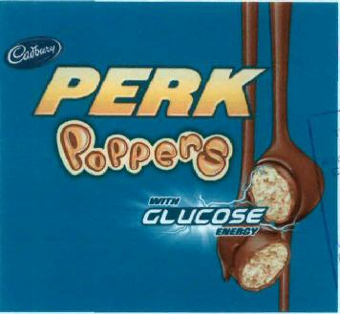




Examples
NAME - TATA / BIRLA / GODREJ
Slogans -

Slide 42





Certification Mark
Institute of Chartered Accountants
Collective Mark
Brooke Bond is used as a Collective Mark for its brands—Red Label, Taj Mahal, and Taaza
Series mark : McDonald has series marks incorporating the term “Mc” like Mc chicken, Mc Café, Mc Donuts etc.

Slide 43

Examples - Sound marks
MGM’s lion roar
3- note Yahoo Yodel
ICICI Bank – (Corporate jingle - Dhin Chik Dhin Chik) - ICICI Bank is the first Indian entity to obtain sound mark registration
National Stock Exchange – (Theme song)
Britannia Industries (Four note bell sound)

Slide 44
Examples
Smell or Scent or Trademarks
Magazines
Pens, paper and erasers
Smell of rose for tyres
Smell of freshly cut grass for Tennis balls
Smell of vanilla for office files

Slide 45


Sony Music Entertainment India Pvt. Ltd., which recorded the Tamil-English song - Trademarked ‘WHY THIS KOLAVERI DI’

Slide 46
Functions of a Trademark
Promotes the image of a company and its range of goods & services
Guards the commercial goodwill of the trader
Indicates the source of goods or services
Protection of consumers from deception
Monetary gains can be achieved by licensing / assignment
A well-chosen and well-publicized trademark often has value far beyond the physical assets of a company, so it should be protected properly.

Slide 47
Requirements
The legal requirements to register a trademark under the Act are:
The selected mark should be capable of being represented graphically (that is in the paper form).
It should be capable of distinguishing the goods or services of one undertaking from those of others.

Slide 48
Not Registrable
If the mark is of such nature as to deceive the public or cause confusion
If it contains any matter likely to hurt the religious susceptibilities of any class or section of the citizens of India. Ex. Ganapathi chapples
If it contains scandalous or obscene matters
If its use is prohibited under the Emblems and Names (Prevention of Improper use) Act, 1950 Ex. UNO, WHO
No indication as to character (Descriptiveness) Ex. BEEF AND BREW restaurants
Shape as to nature and technical result Ex. Shape of football
Exceptions
Honest and concurrent use
Acquiring distinctive character/secondary meaning by its use or well-known
Ex. Head & Shoulders, Fair & Lovely

Slide 49
Term of Protection
Initial registration of trademark shall be for a period of 10 years and can be renewed from time to time for an unlimited period by payment of renewal fees.

Slide 50
Trademark symbol
A Trademark may be designated by the following symbols:
TM - For an unregistered trademark
® - Registered trademark
Ex: Paradise®

Slide 51
Passing off action for Unregistered Trademark
Passing off is a form of tort used to enforce unregistered trade mark rights.
The tort of passing off protects the goodwill of a trader from a misrepresentation.
No one is entitled to represent his goods or services as being the goods or services of another

Slide 52
Type of Applications
Ordinary application:
An ordinary application does not claim priority.
Reciprocity application:
A reciprocity application claims priority of an application filed previously in a convention country. Such an application shall be filed in India within six months from the date of filing in convention country.

Slide 53
International Trademark Registration
Madrid system - Administered by WIPO ~ 121 countries
  Trademark protection can be obtained in many jurisdictions by filing one application, in one language with one set of fees, and make any changes (e.g. changes of name or address) and renew registration across all applicable jurisdictions through a single administrative process

Slide 54
COPYRIGHT
Copyright © 2020, Sailaja Sarvepalli, All Rights Reserved.

Slide 55






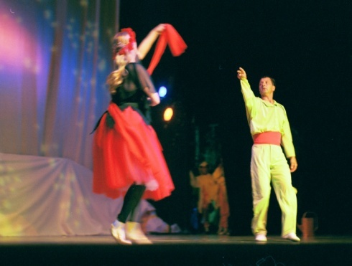
COPYRIGHT
Copyright is a right given by the law to creators of literary, dramatic, musical and artistic works and producers of cinematograph films and sound recordings.
Musical
Films
Literary
Artistic
Dramatic
Sound Recording

Slide 56
COPYRIGHT
Copyright gives protection for the expression of an idea and not for the idea itself.
For example, many authors write textbooks on physics covering various aspects like heat, optics etc. Even though these topics are covered in several books by different authors, each author will have a copyright on the book written by him, provided the book is not a copy of some other book published earlier.

Slide 57

REQUIREMENTS OF COPYRIGHT PROTECTION
“Originality” – it should originate from the author – product of independent creation
“Fixation” – should be fixed in a medium i.e., medium can be a piece of paper, cassette,etc

Slide 58
Copyright
Copyright subsists worldwide
Acquisition of copyright is automatic and it does not require any formality, but it is advisable to register.
Certificate of registration of copyright - serves as prima facie evidence in a court of law with reference to dispute relating to ownership of copyright.

Slide 59
Term of Copyright Protection
Life of Copyright owner + 60 years
Literary
Dramatic
Musical
Artistic works
60 years
Cinematograph films
Photographs
Sound recordings
Posthumous publications
Anonymous and pseudonymous publications
Government works
International organisations works

Slide 60
WHO OWNS THE COPYRIGHT IN A WORK?
Author is the first owner of copyright in a work
    Exceptions:
Written agreement to the contrary
Made for valuable consideration
Employer

Slide 61
COPYRIGHT – A BUNDLE OF RIGHTS
Economic Rights
  Reproduction or make copies
  Issue copies- sell, distribute, etc .
  Performance
  Communication to public
  Adaptation
  Translation
  Assignment / License

Slide 62
COPYRIGHT – A BUNDLE OF RIGHTS
Moral rights are independent of the economic rights of author and remains with him even after assignment of the copyright.
  Right to Paternity - Claim of authorship of the work
  Right to Integrity - Object against mutilation/distortion of work

Slide 63
Copyright Societies
Copyright Societies – Issues licenses, collects and distributes royalties after making deductions for the administrative expenses.
Registered copyright societies in India
Society for Copyright Regulation of Indian Producers for Film and Television (SCRIPT) 135 Continental Building, Dr. A.B. Road, Worli, Mumbai 400 018, (for cinematograph and television films)
The Indian Performing Right Society Limited (IPRS), 208, Golden Chambers, 2nd Floor, New Andheri Link Road, Andheri (W), Mumbai400 058 (for musical works)
Phonographic Performance Limited (PPL) Flame Proof Equipment Building, B.39, Off New Link Road, Andheri (West), Mumbai 400 053 (for sound recordings) , etc

Slide 64
INDUSTRIAL DESIGNS

Slide 65
Industrial Design under the Designs Act, 2000
Design refers to the features of
Shape
Configuration
Pattern
Ornamentation
Composition of lines or colors
applied to any article, whether in two or three dimensional or in both forms, by any industrial process or means whether manual, mechanical or chemical, separate or combined, which in the finished article appeals to and judged solely by the eye.
Article means any article of manufacture and any substance, artificial, or partly artificial and partly natural; and includes any part of an article capable of being made and sold separately.

Slide 66



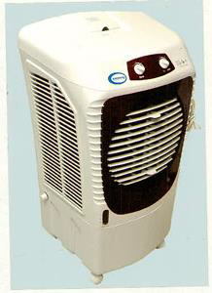




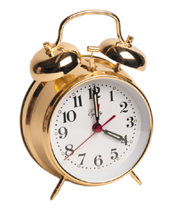

Examples
Perfume Bottle

Slide 67
Benefits of Design Registration
Exclusive right to apply a design to the article in the class in which the design has been registered.
Owner can license or sell or mortgage his design as legal property for a consideration or royalty.
Safeguards the owner from unauthorized access by others.
Adds value to a company or to its products
Provides commercial advantage
Encourages fair-trading, promote creativity, and contributes to economic and social development.

Slide 68
Essential Requirements for Design registration
A design should :
Be new or original
A design is considered to be new when it has not been disclosed to the public, anywhere in India or in any other Country, by publication or by use or in any other way, prior to the filing date or priority date.
‘Original’ in relation to a design, means:
a. originating from the author of design, and
b. includes the cases, which though old in themselves yet are new in their application. Ex: making a flower vase in the form of figure of Taj Mahal
Be significantly distinguishable from known designs or combination of known designs.
Be applied to an article and should appeal to the eye.
Not be contrary to public order or morality

Slide 69
Type of Applications
Ordinary application:
An ordinary application does not claim priority.
Reciprocity application:
A reciprocity application claims priority of an application filed previously in a convention country. Such an application shall be filed in India within six months from the date of filing in convention country. This period of six months is not extendable.

Slide 70
Protection at Home and Abroad
Industrial design rights are territorial, so rights are limited to the country (or region) where protection is granted.
The national route
Apply in Each country where you seek protection
The regional route (for some countries only which are members of a regional agreement)
  African Intellectual Property Organization (OAPI) - Bangui Agreement;
  African Regional Intellectual Property Organization (ARIPO)-Lusaka Agreement;
  Benelux Office for Intellectual Property (BOIP) - Three “Benelux” countries; and
  Office for Harmonization in the Internal Market (trademarks and designs) (OHIM)- European Union
  The international route
  Hague agreement - Administered by WIPO ~ Registration in 83 territories - one single international application, all the designs must belong to the same class of the Locarno Classification.

Slide 71
Classification of Goods
In the Designs, classification of goods are given in the Third Schedule based on Locarno Agreement.
Example : If the article relates to ‘Watches’, the name should be provided accordingly and should be classified under Class 10 and sub-class -02.
32 classes
Protection is confined to that class in which the design is registered

Slide 72
Classification of Goods
It may be noted that for registering a design in more than one class, a separate application is required to be filed for each class.
In case, the applicant has already registered a design in any other class of articles, the fact of such registration along with the registration number shall be mentioned in Form-1.
More than one design may be registered as a set of articles if meets the following requirements :
a. Ordinarily on sale or intended to be used together,
b. All having common design even though articles are different (same class),
c. Same general character.
Ex: tea set, dinner set, furniture set etc.

Slide 73
Term of Registered Design
Ten years from the date of registration
Extendable for another Five years
Cease of Design
Non-payment of extension fee before due date results in to ceasing of design

Slide 74
Rights in lapsed design, which has been restored
A proprietor shall have no right to institute a suit or
proceeding in respect of piracy of design or infringement of copyright, which has been committed between the date on which the design ceased to have effect and the date of
restoration of the design.

Slide 75
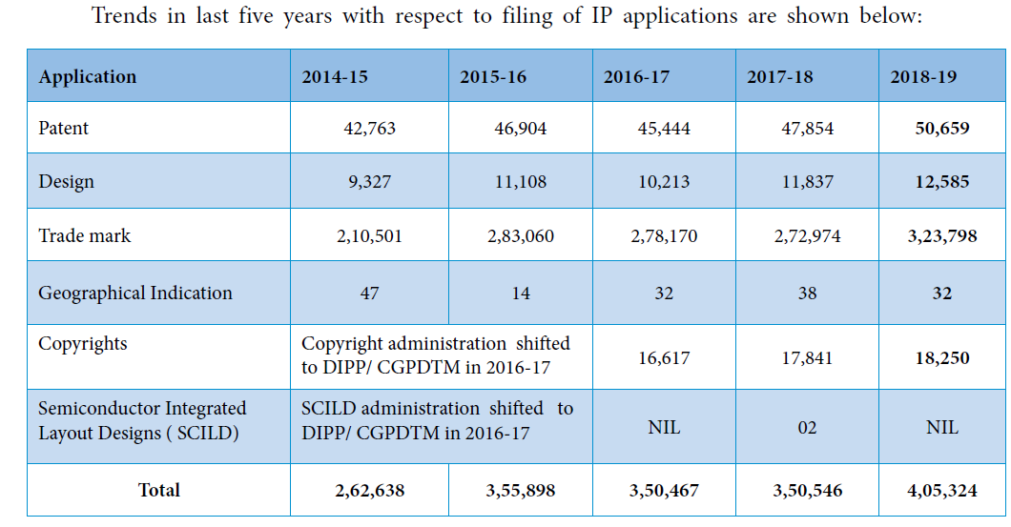
2019-20
56,284
14,272
3,34,815
21,905

Slide 76
India’s ranking in the Global Innovation Index 2021 has climbed 35 notches, from 81st in 2015-16 to 46th in 2021, released by the World Intellectual Property Organization.
India has improved its overall IP score from 38.4 per cent to 38.6 per cent, and the country is ranked 43 out of 55 countries on the International Intellectual Property Index 2022. This index was released by the Global Innovation Policy Center of the U.S. Chamber of Commerce.
The number of patent filings increased from 42,763 in 2014-15 to 66,440 in 2021-22.
India granted 30,074 patents in 2021-22 as compared to 5,978 in 2014-15.
For the first time in the last 11 years, the number of domestic patent filing has surpassed the number of international patent filing at Indian Patent office in January-March 2022 quarter. Of the total 19,796 patent applications filed, 10,706 were filed by Indian applicants and 9,090 by non-Indian applicants.

